Slide 1
THasyINKnc Thanks Curtissimo!
Multi-threaded Programming in .Net
Eric Burcham – Improving Enterprises
Source at: http://github.com/ericburcham/THasyINKnc/

Slide 2
Eric Burcham
Likes
Dogs
Most people
Telling bad jokes
The words “bro” and “totally.” I’m not kidding.
¡ɹ0x0q ɹn0ʎ 9u!ʞɔ@ɥ
Dislikes
Dog hair
A few people
Telling jokes that don’t work (Happens a LOT)
Making lists of stuff

Slide 3
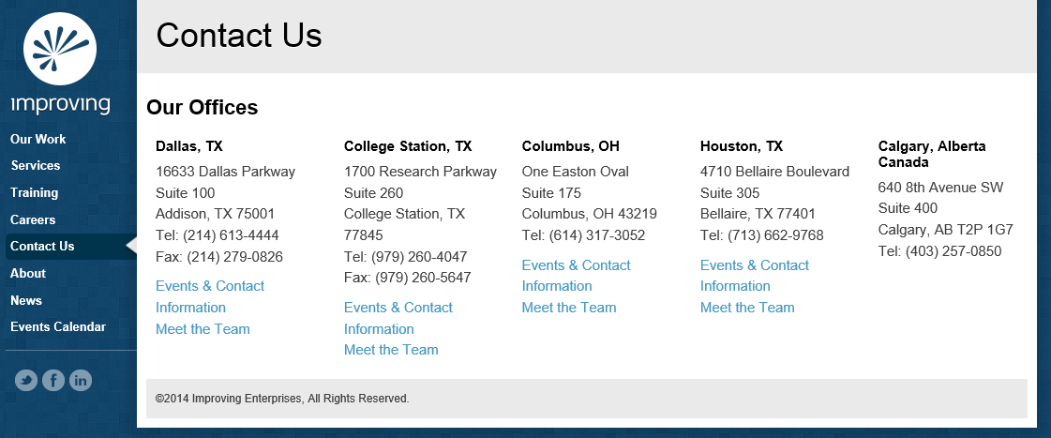
I’m an Improver
Principal Consultant with Improving Enterprises
We’re hiring (Attitude and Aptitude)
You should totally call me, bro: 214-578-9217
Or email: eric.burcham@improvingenterprises.com
We have a website: www.improvingenterprises.com
Go Now!!!

Slide 4



Coming Soon to a Theatre Near You
Tuesday, August 11, 2015
8am-5pm
Studio Movie Grill City Center
Register now AgileDotNext.com
Get 10% off by entering IEfriends

Slide 5

Houston TechFest
All-day Internet and Technology Conference
September 12, 2015
It has a logo. Here it is!!!
It’s pretty much free. As in free beer. There’s gas and your time and stuff, but whatever…
It actually has pretty decent speakers.
WAY better than me.
I’ll be there too, though, probably.

Slide 6
Broism: Bilbro Baggins
Bilbro Baggins: Your bro who is obsessed with Lord of the Rings. Example: Joe has seen the twin towers like 5 times. He’s such a Bilbro Baggins.

Slide 7
Overview
Lots of bad jokes (I can’t help it).
When to use threads.
Basics of multi-threading in .Net
Multi-threaded programming patterns
Parallel Linq
Task Parallel Library
Async Controllers (and why they matter)

Slide 8
Word Joke
Why is it so hard to explain puns to kleptomaniacs?

Slide 9
When to Use Multi-threading
Application is CPU bound and not using all cores. The task manager tells the story.
Application is waiting on external resources that can be loaded in parallel.
Only when the benefits outweigh the costs.

Slide 10
Superhero Joke
Sixteen sodium atoms walk into a bar, followed by Batman.

Slide 11
A Word of Caution
I’m not an expert.
Can become a minefield of subtle and hard to reproduce defects.
More computing sins are committed in the name of efficiency that for any other single reason, including blind stupidity – W.A. Wulf
Premature optimization is the root of all evil – Donald Kuth
Jackson’s Rules of Optimization
Don’t do it.
(For experts only): Don’t do it yet.
Eric’s Rule of Optimization
Do whatever the heck you want!

Slide 12
Language Joke
What’s the difference between an etymologist and an entomologist?

Slide 13
How to Begin
Understanding your application and what can be done in parallel CANNOT be skipped.
Look for potential parallelism across the application as a whole.
Prepare your application for parallel execution my making structural changes.
Sound vague? Know the patterns and the problems they solve!

Slide 14
Profiling Joke
There are only two types of people in this world…

Slide 15
Tips and Tricks
Locks are the “goto” statement of multi-threading.
The code NEEDS to be correct. If you aren’t certain, seek help. This stuff is hard!
Don’t share data among threads unless absolutely necessary.
Try to use threads and locks as a last resort. Try to raise the level of abstraction from threads to tasks.

Slide 16
Math Joke
An infinite number of mathematicians walk into a bar.

Slide 17
Warm Up Your Internal Compiler…
case class She(){ def have(f: => Unit) = new { def til(c: => Boolean) = {do{f} while (!c)} } } case class TBird(){ } case class Daddy(){ def takeAway(t: TBird) = { println("Daddy took the T-Bird away.") true } } object Solution { def main(args: Array[String]) { val funFunFun = {println("Fun! Fun! Fun!")} She() have(funFunFun) til(Daddy() takeAway(TBird())) } }
Check out Scala… http://www.scala-lang.org/

Slide 18
Basics of Threading in .Net
Threading hello world
Passing parameters to threads
Data races and locking
Deadlocks, waiting, and pulsing
Wait handles, Reset Events, and Mutexes
Using the thread pool and asynchronous methods.
Shutting down workers
Volatility, atomicity, and interlocking
Locking (and choosing what to lock on)
Alternative approaches to monitors
Thread-safety
Aborting and interrupting threads
Error handling
Testing Parallel Code
F# Examples
GPU (Cuda / OpenCL) Examples

Slide 19
Sarcasm Joke
An MIT linguistics professor was lecturing his class the other day…

Slide 20
Parallel Design Patterns
Parallel Loops
Parallel Tasks
Parallel Aggregation
Futures (Task Graph)
Pipelines

Slide 21
Parallel Loops
Perform the same independent operation on each element of a collection or for a fixed number of iterations.
Steps are independent if they don’t write to memory locations, files, or other resources that are used by other steps.

Slide 22
Anti-Patterns
Step size != 1: Often indicates data-dependency.
Hidden loop body dependencies: Don’t try to share instances that are not thread-safe, for example. Random is a culprit in one of my examples.
Small loop bodies with few iterations: You won’t get enough performance improvement to justify the complexity.
Processor over/under subscription: Having many more or fewer threads running than available underutilized cores.

Slide 23
Recursion Joke
What does the “B” in Benoit B. Mandelbrot stand for?

Slide 24
Parallel Tasks (Fork/Join, Master/Worker, Etc…)
Distinct operations that can run simultaneously.
Multiple operations, each with its own distinct input.
Parallel steps should be independent, but not necessarily perform the same operation.

Slide 25
Task Lifecycle
Waiting to Run
Running
Cancelled
Faulted
Run to Completion

Slide 26
Anti-Patterns
Variables captured by closures: lambdas and anonymous methods can refer to variables outside their lexical scope. For example, referencing a loop indexer used to create tasks can have unexpected results.
Disposing a resource needed by a task: Careless use of the C# using keyword is a common mistake here.
Using Thread.Abort: This commonly leaves the application domain in an unusable state.

Slide 27
Rhetorical Joke
What do you get when you cross a joke with a rhetorical question?

Slide 28
Parallel Aggregation (Parallel Reduction)
Similar (generally) to Parallel Loops, but with interdependent results. For example, IEnumerable<T>.Sum() and IEnumerable<T>.Average() can be made parallel.
Uses unshared local variables that are merged at the end of the computation to give the final result.
Works for any binary operation that is associative.
.Net implementation is also commutative.

Slide 29
Parallel Aggregation Workflow
…
Accumulate Into Subtotal
Add Subtotal to Result
…
Accumulate Into Subtotal
Add Subtotal to Result
…
Accumulate Into Subtotal
Add Subtotal to Result
Partitioned Input Values
Independent Tasks
Coordinated by serializing locks
Return Aggregate Result

Slide 30
Lame Joke
Audience Participation: Mr. Curtis Schlak

Slide 31
Futures (Task Graph)
Provides a stand-in for a result that is initially unknown but becomes available at a later time.
The process of calculating the result can occur in parallel with other computations.
Integrates parallel tasks with the familiar world of arguments and return values.
Integrates Control Flow and Data Flow

Slide 32
A Visual Task Graph
a
a
f2(a)
f1(a)
c
f3(c)
b
d
f4(b, d)
f

Slide 33
Lame Joke
Audience Participation: Paul DeCarlo

Slide 34
Pipelines
Uses parallel tasks and concurrent queues to process a sequence of input values.
Each task implements a stage of the pipeline.
Queues act as buffers that allow the stages to execute concurrently, even though the inputs are processed in order.
Analogous to an assembly line.

Slide 35
A Sentence Creation Pipeline
Inputs
Read Strings
Buffer 1
Correct Case
Buffer 2
Create Sentences
Buffer 3
Outputs
Write Sentences

Slide 36
Anti-Patterns
Thread starvation: If there are not enough threads to run all pipeline tasks, the blocking collections can fill and block indefinitely.
Infinite blocking collection waits: If a pipeline task throws an exception, it will no longer take values from its input blocking collection. If the input collection is full, the task that fills it will block. Be sure to cancel pipelines if you anticipate this situation.
Forgetting GetConsumingEnumerable(): Blocking collections implement IEnumerable<T>, so this is easy to forget. If you forget, the enumeration will be a snapshot and won’t consume from the collection.
Using other flavors of IProducerConsumerCollection for your blocking collections: ConcurrentStack may never consume the earliest entries, for examples.

Slide 37
Lame Joke
Audience Participation!

Slide 38
Other Examples
Async Controllers
Finding “Similar” Strings
Parallel Quick Sort

Slide 39
Questions And Answers
You line ‘em up.
I’ll knock ‘em down.
If I say something dumb and you know better, SPEAK UP!

Slide 40
We’re Hiring
Senior .Net Developer
Business Development Manager
Program Manager
Email Valerie Carmona: Valerie.Carmona@improvingenterprises.com

